Slide 1
INCOME TAX ANALYSER USING TKINTER
PROJECT MEMBER:HEMANTH KUMAR B
212220040047
PROJECT GUIDE: DR.V. UMARANI

Slide 2
ABSTRACT
To calculate a income tax of a salaried person
It improve the quality application for both new and existing old taxes slabs.
It creates the report of tax using old tax regime and new tax regime.
It helps the user to select the tax slab according to the report

Slide 3
OBJECTIVE:
Main Objective is to build a GUI application for Income tax Analyzer.
Income tax Analyser helps to manage their taxes and to choose best suitable tax regime(old or new)
To creates an opportunity to check how much they have opting tax system over the year
It creates a user friendly interface by giving brief idea to enter the details through images.
No-prior Knowledge is needed.

Slide 4
Existing System:
Online tool provided by income tax website for calculating tax.
It helps to calculate the tax for the financial year.
It provides basic information for paying taxes.
They didn’t provide any comparision to old and new tax regime

Slide 5
PROPOSED SYSTEM
The tool works completely offline and compare Old tax slabs and New tax slabs
Recommend which tax slab is better to follow.
Calculate how much tax have to pay for the financial year
It reduce time consuming and provide money saving.

Slide 6
PROJECT ENVIRONMENT:
HARDWARE REQUIREMENT:
PHYSICAL SYSTEM
SOFTWARE REQUIREMENT:
VISUAL STUDIO CODE,
OS: WINDOWS 10 OR ABOVE

Slide 7
ARCHITECTURE
Users can always reset the input values by clicking the Reset button.
The Exit button in the bottom right corner successfully terminates the application and TAX ANALYSER is closed.
Upon clicking the Check tax schems button in the bottom right corner a pop up window appears having details of all the Taxes Rates

Slide 8
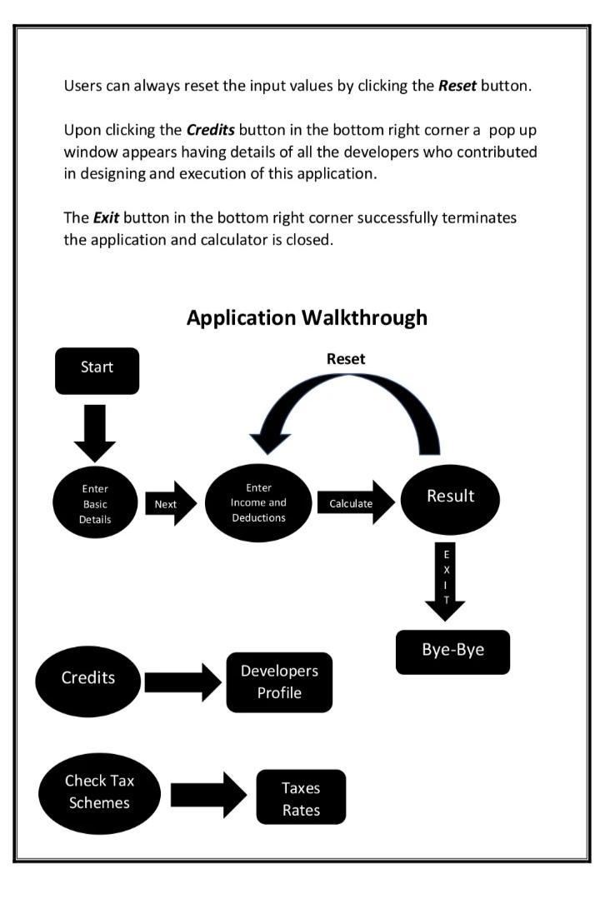

Slide 9
MODULES
Create splash screen
Create keyboard for contact number ,income and exemption/deduction,email id.
Create clear and next with its functionalites
Creating Deductions tab
calculating the taxes of person
creating pdf report of the Tax

Slide 10
REFERENCE:
INCOME TAX OF INDIA
https://www.incometax.gov.in/
TKINTER DOCUMENTATION

